Slide 1
Compound Governance
By bcYng
2022.7.12

Slide 2
Overview
Intro
Token
Alpha
Bravo
Summary

Slide 3
Intro
Compound governance implements the governance of defi by putting forward proposals and voting fairly

Slide 4
Governance Token

Slide 5
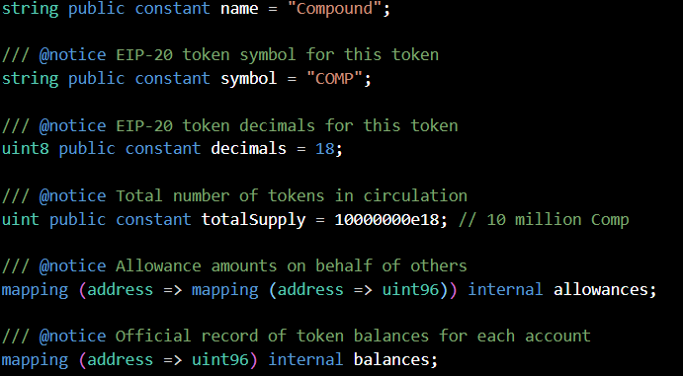
Comp, an erc20 token representing vote, contains some related governance methods

Slide 6
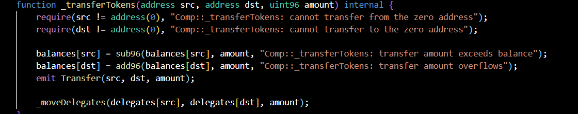
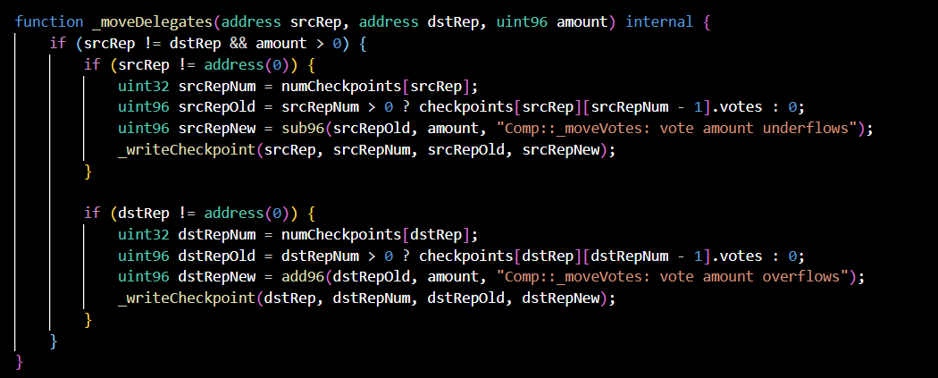
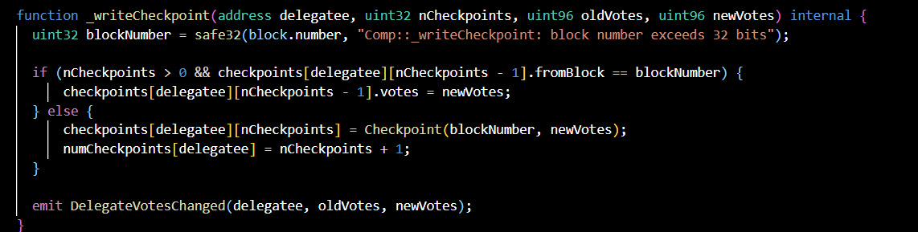
Token represents vote, which transfers assets and transfers vote during transfer（1T1V）

Slide 7
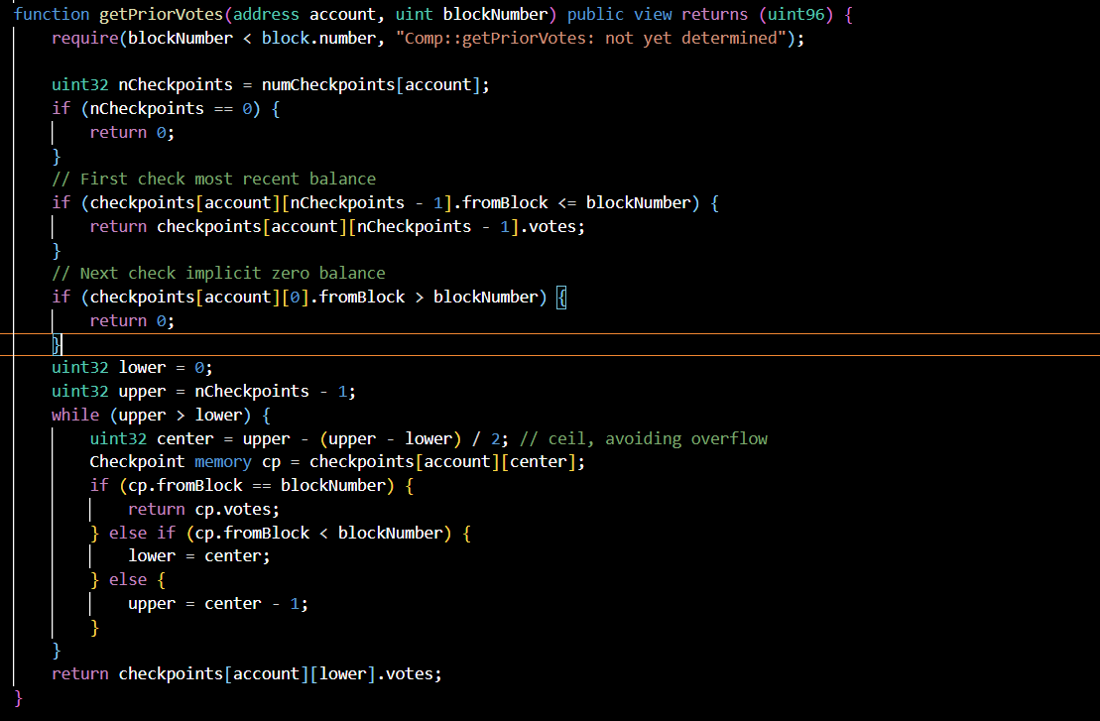
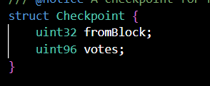
Record the voting rights under a block number. We can call getpriorvotes to retrieve the value. When called, it will judge the blocknumber searched by fromblock for comparison, so it is only applicable to past blocks

Slide 8
Governance Alpha

Slide 9
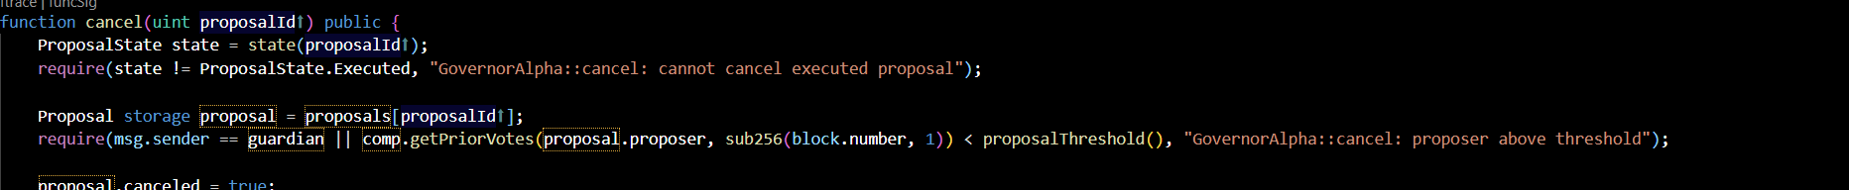
There are corresponding restrictions on the submission, cancel, voting, queuing and implementation of proposals

Slide 10
Provide target,values, functions name, calldata and descriptions when creating a proposal
The first four parameters are used for execution after the proposal is succeed
The last parameter is used to describe the proposal

Slide 11
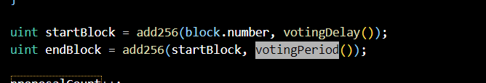
After the proposal is submitted, the voting does not begin immediately, but after waiting for a block, the voting lasts for 3 days

Slide 12
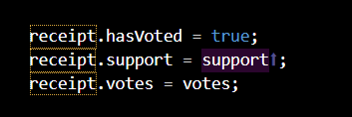
When voting, take the number of votes of voters in the start block as the weight, and it is required to vote only once for a proposal
Record voter voting information

Slide 13
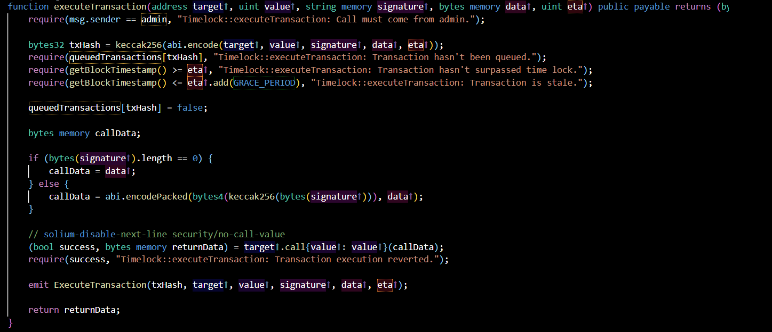
After the proposal is passed, it cannot be executed immediately, but wait for a period of time (Timelock. Delay()), It can be cancelled during the publicity period.The proposal is implemented through the call method in the Timelock contract

Slide 14
Voting will produce two results, successful or defeated
If the number of supporting votes is less than the number of opposing votes or the number of supporting votes does not reach the quorum number of votes, it will be deemed as failure

Slide 15
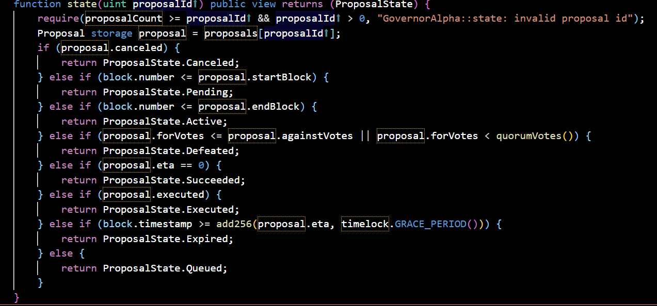
The following is the full status of the proposal and the basis for judgment

Slide 16
Governance Bravo

Slide 17
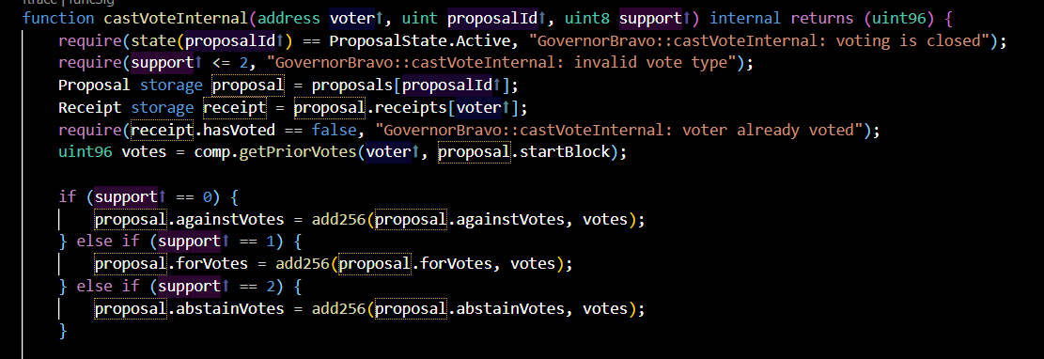
When voting, change the bool type support to uint8 type, and only 0, 1 and 2 values are valid values, which is equivalent to adding a abstention vote in the case of support or not

Slide 18
Many agreements have a large part of the voting rights concentrated on early investors, who may want to show their participation without deciding the voting results. Therefore, abstention is the third voting option

Slide 19
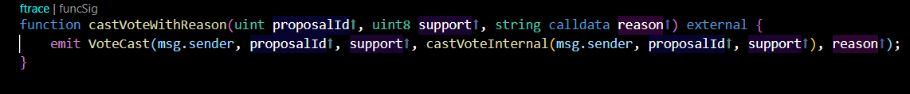
At the same time, castvotewithreason, which allows voters to vote for certain reasons, is another change made in the voting
The third parameter is the reason for support, opposition or abstention

Slide 20
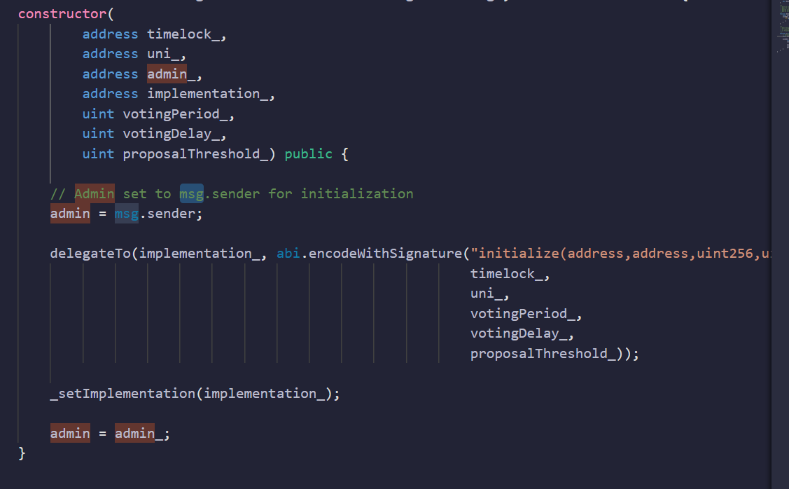
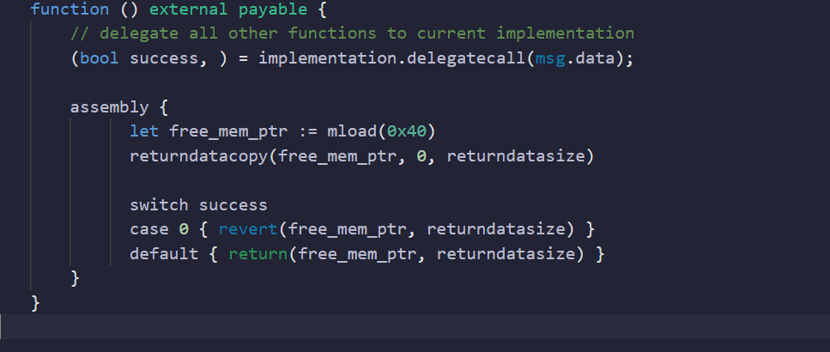
The contract uses the proxy method，The contract uses the proxy method to execute the implementation content under the delegator contract
In this way, the contract can be updated by updating the address of the logical contract

Slide 21
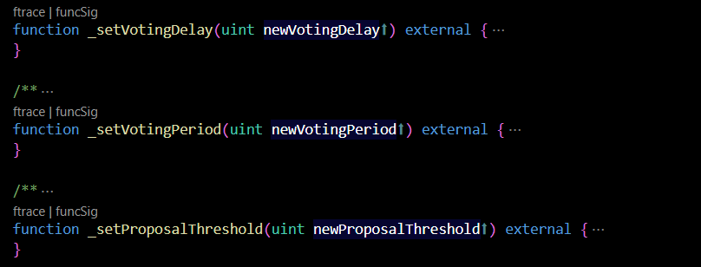
In governance Bravo, variables can be modified after contract deployment, such as votingdelay, votingperiod , proposalthreshold etc

Slide 22
By setting admin as the timelock contract address, modify the above parameters by voting decision execution

Slide 23
The logic of the contract code of Governance Bravo is roughly the same as that of Governance Alpha, and the rest is not analyzed too much. Next, let's take a proposal as an example to understand the working mechanism and make a summary

Slide 24
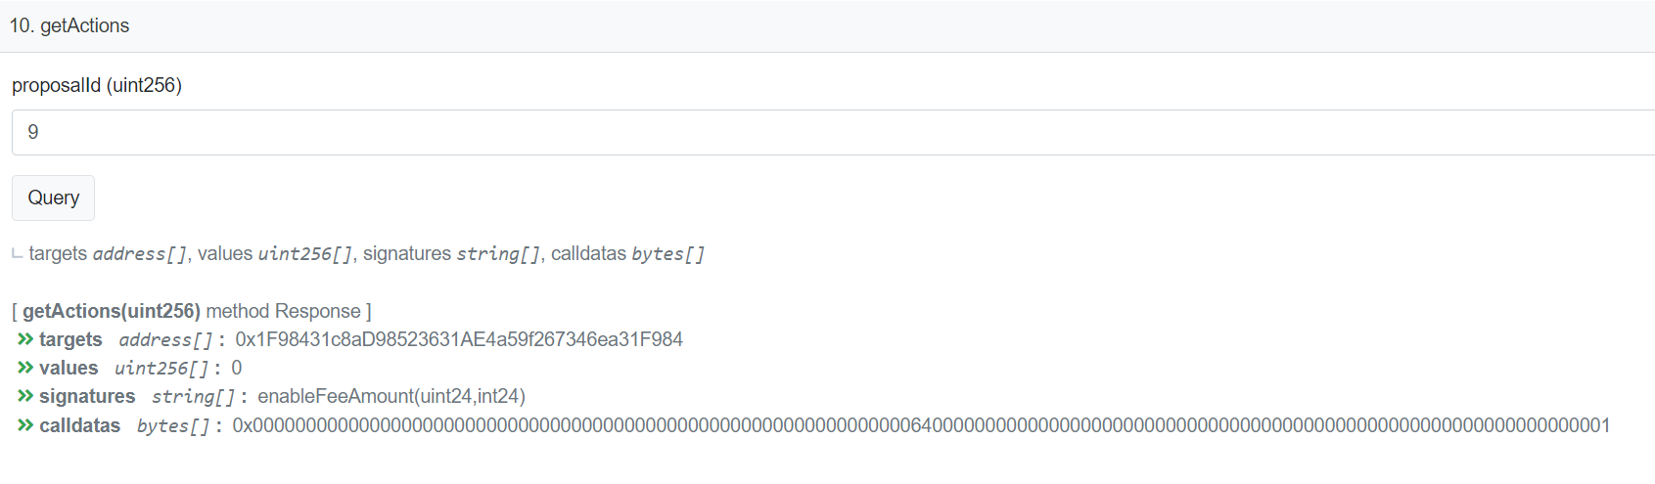
An Example on Uniswap V3
Call the enablefeemount function under the target contract address, and the parameters correspond to 64 and 1

Slide 25
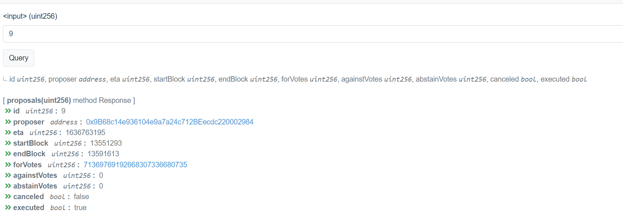
The above figure shows the status of the proposal, including the number of support votes and negative votes. Finally, the feeAmountTickSpacing[64] is modified to 1

Slide 26
Summary
Community, not centralized, decisions

Slide 27
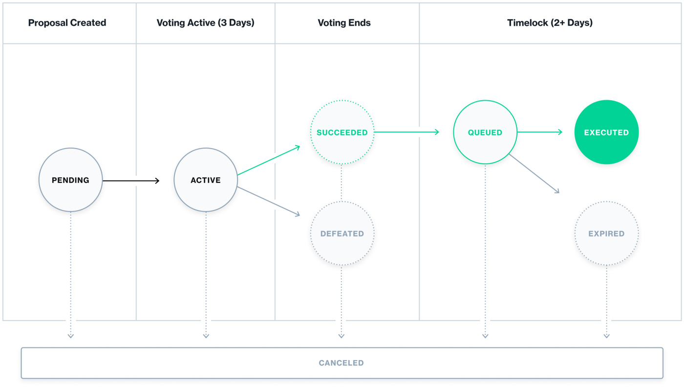
As a typical Dao model, compound governance is used and followed by many defis

Slide 28
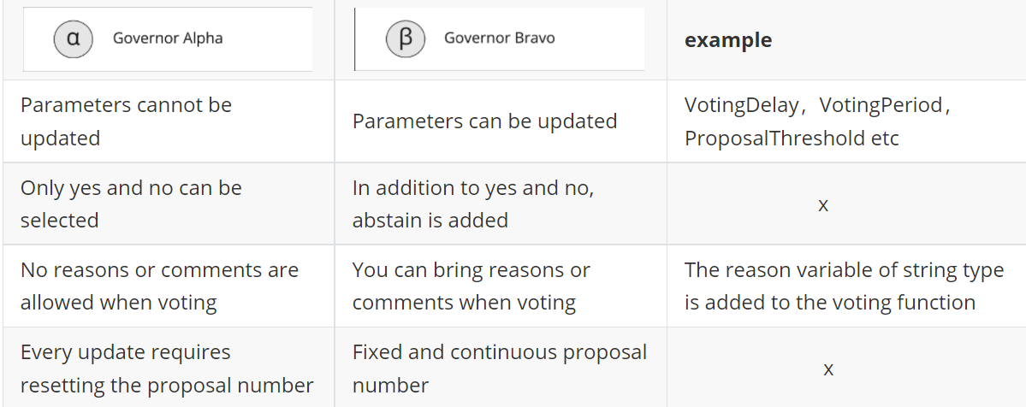
Alpha and Bravo have the same logic but different ones, realizing the refinement of functions and the optimization of contracts

Slide 29
See bcyng’s Blog for more details

